Slide 1

Wine Project
Data Warehousing, Data Mining and Visualization
IS-665 Fall 2019
Professor Yegin Genc, PhD
Pacers Worldwide
Ana Abreu
Jeffrey Silver
Sneha Gondane
Wiroon Bowonthanasan

Slide 2
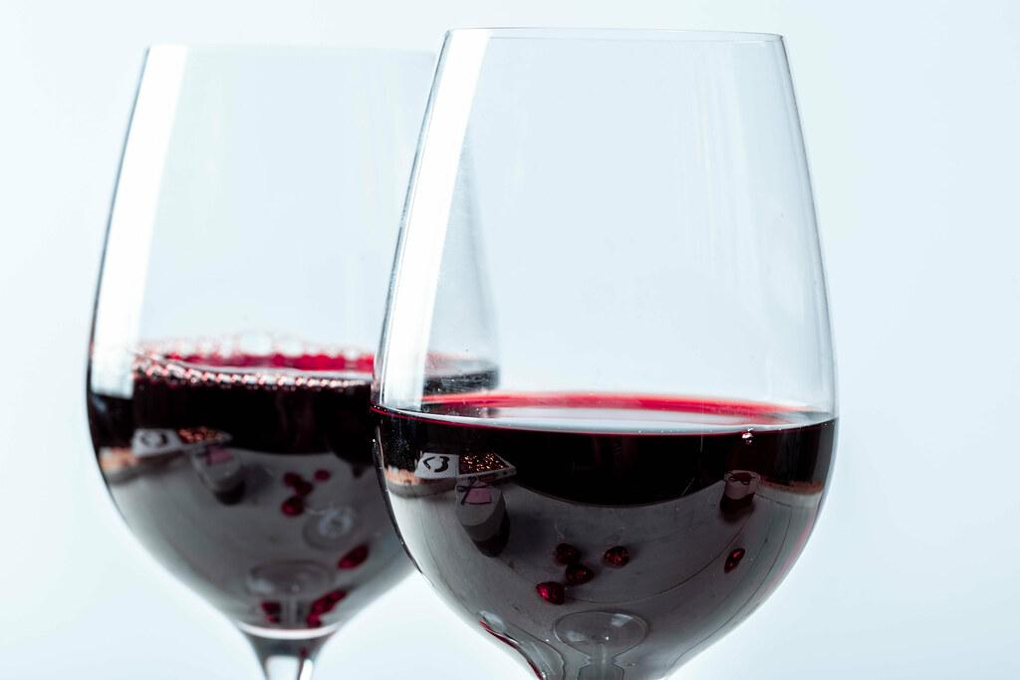
Introduction
A dataset with more than 6,000 wines including both red and white wine.
Why data analysis is needed for this?
Comparing similarities and differences and categorize wine.
How do you expect your analysis to improve decision making in this area?
The analysis and predictions could help individuals to make more informed wine purchases.
Notes:
Wiroon

Slide 3

Dataset
This dataset was found in data.world (https://data.world/food/wine-quality).
The data cleaning process
Two new columns were added: “Red_or_White” and categorical column for quality.
What are your variables?
Fixed acidity, Volatile acidity, Citric acid, Residual sugar, Chlorides, Free sulfur dioxide, Total sulfur dioxide, Density,Mass/Volume pH, Sulphates, Alcohol, Quality
Notes:
Wiroon

Slide 4
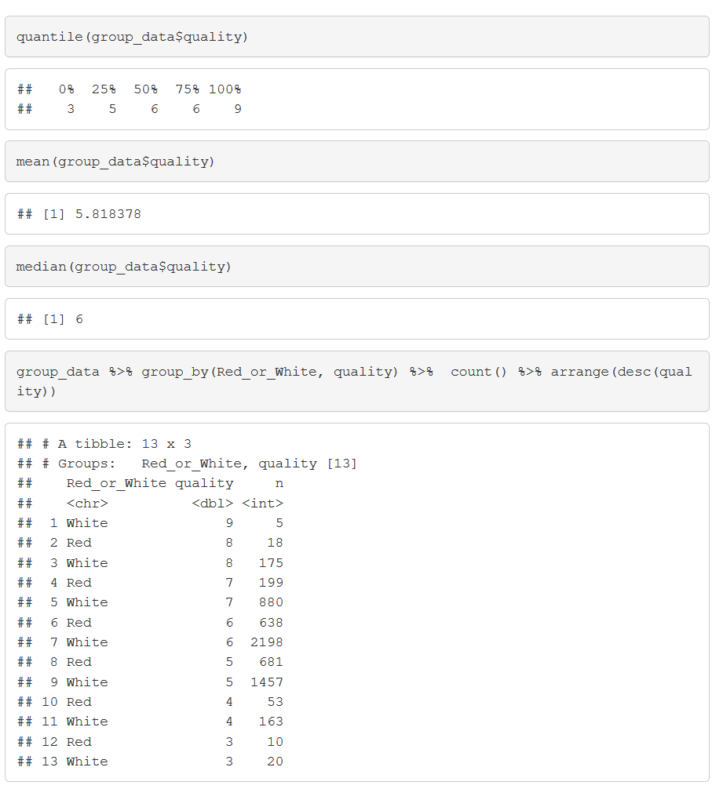
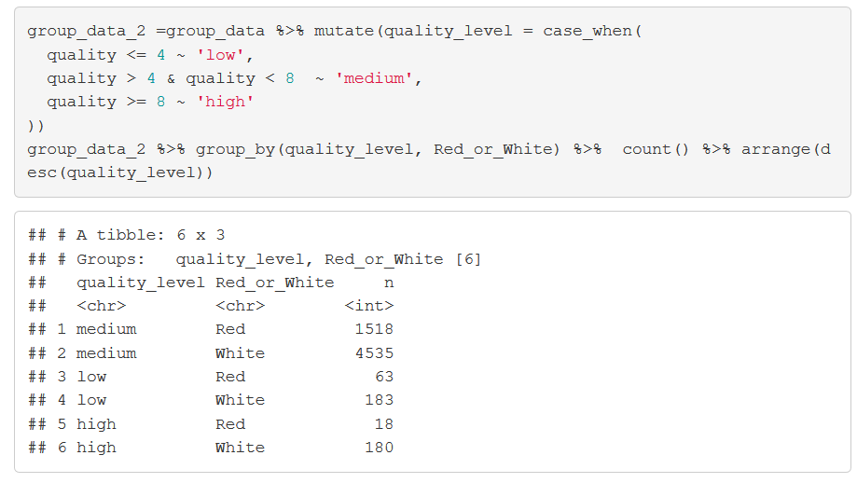
Exploratory Analysis
Notes:
Wiroon

Slide 5
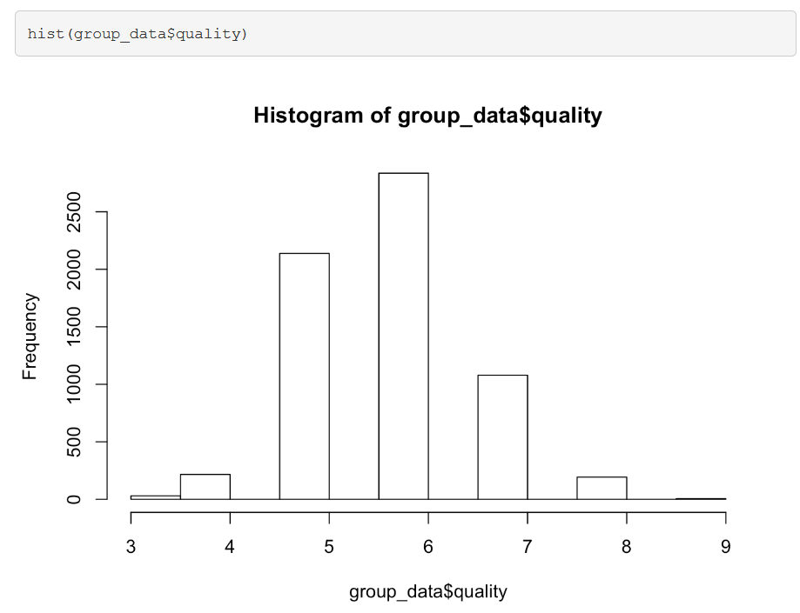
What is the distribution of wine in the data set? Red vs White & Quality?
Notes:
Wiroon

Slide 6
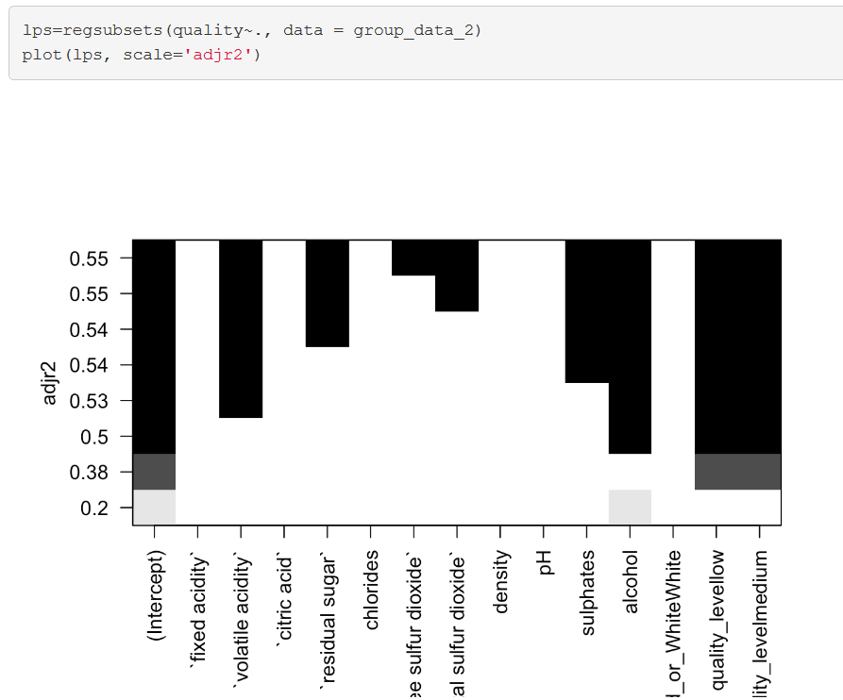
What variables determine quality of wine?
Notes:
Ana

Slide 7
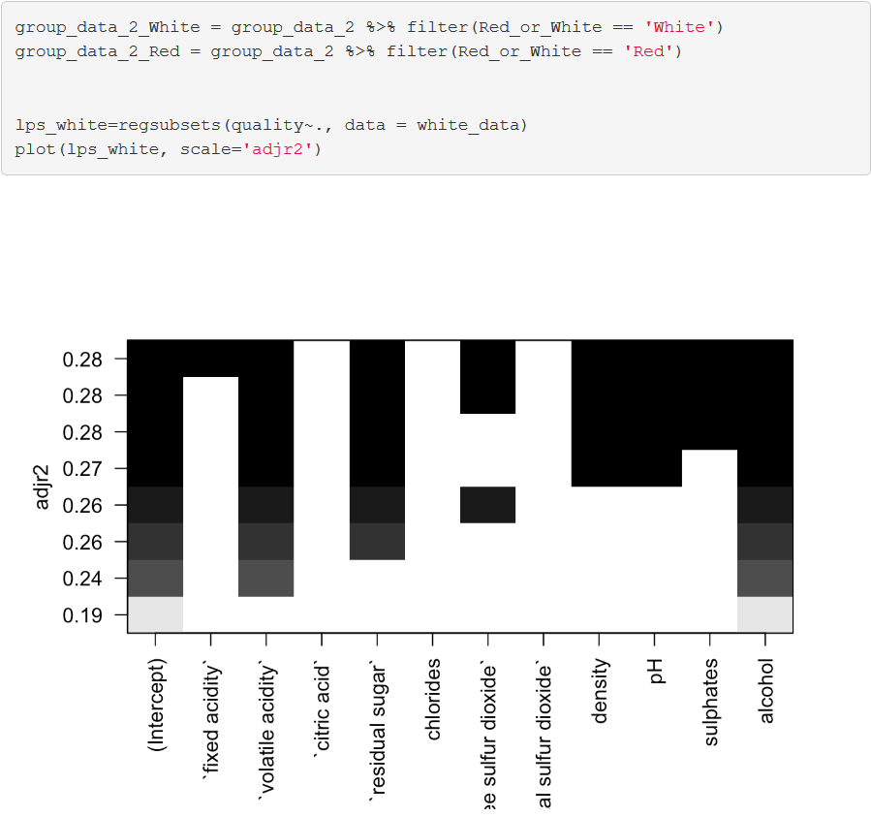
Are there differences between white and red wine that are more informative where variables can determine white or red?
Notes:
Ana

Slide 8
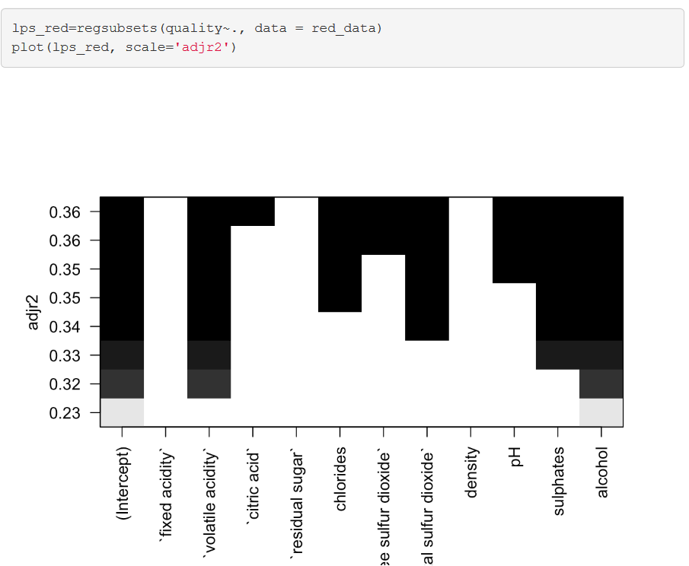
Notes:
Ana

Slide 9

Predictive Analysis
We want to try to predict if a wine is red or white based on certain characteristics.
Hope to help explain features in red and white wine that make sense for certain foods.
Notes:
Sneha (LM part)

Slide 10
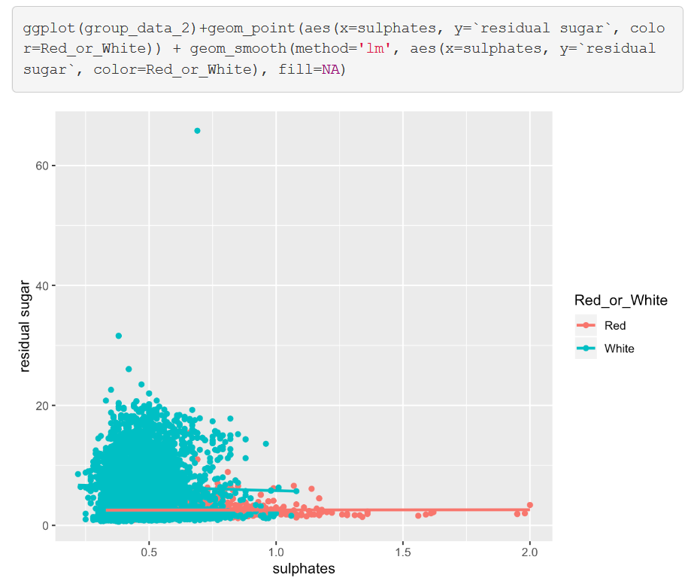
Model Building
Notes:
Sneha

Slide 11
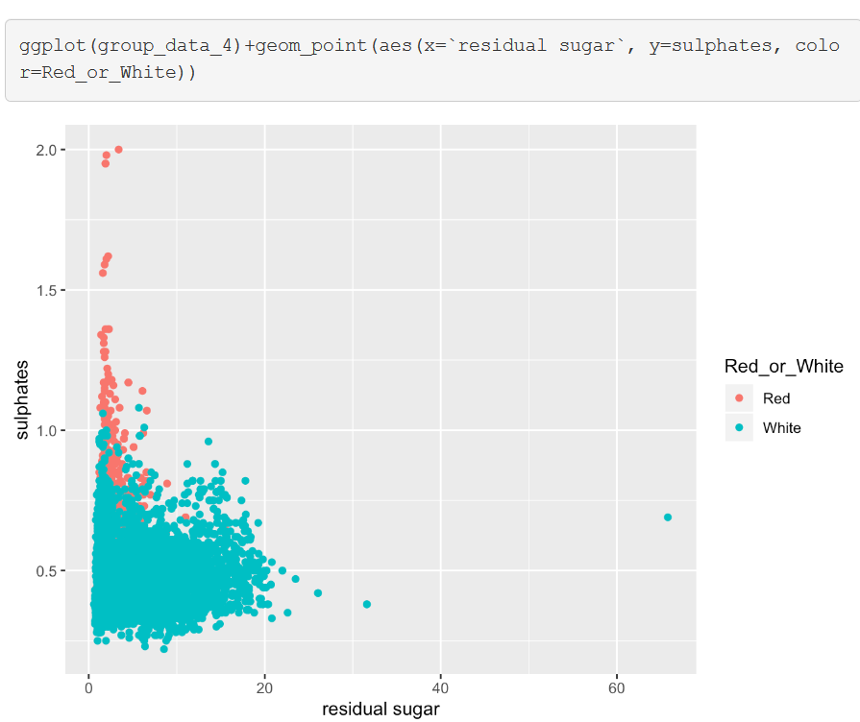
Notes:
Sneha

Slide 12
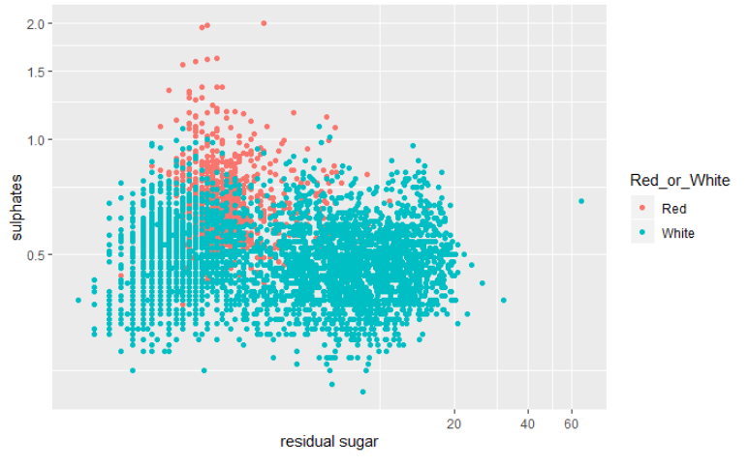
Notes:
Sneha

Slide 13
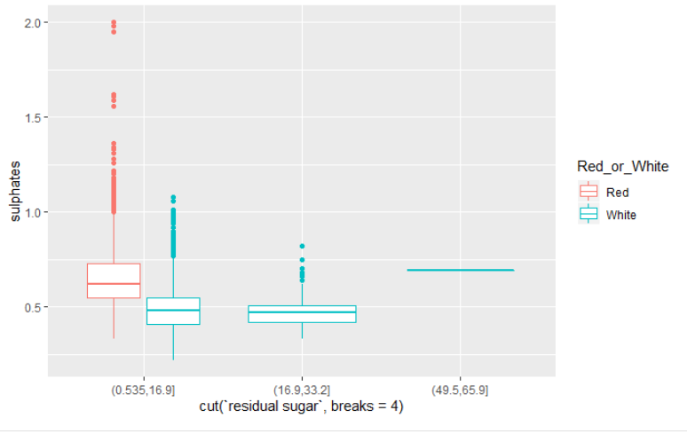
Notes:
Sneha

Slide 14
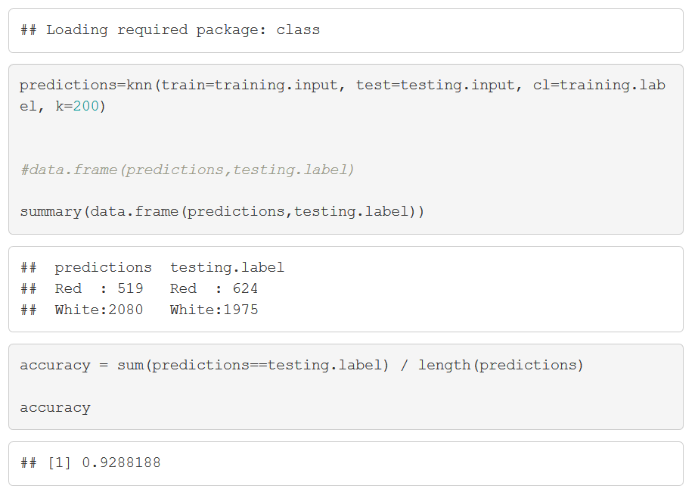
Predictions - 60 / 40 ratio for training / test data
Notes:
Jeff

Slide 15
Conclusion
Our model predicted whether a wine is red or white with about 93.4% accuracy (when k=8, accuracy reduces by 1% when k != 8).
This prediction shows how there are unique distinctions between red and white wine which can be identified with characteristics that make them up. However there are also similarities even between red and white wine that need to be further investigated.
White wine tends to have more sugar and red wine tends to have more sulfites.
Notes:
Jeff

Slide 16
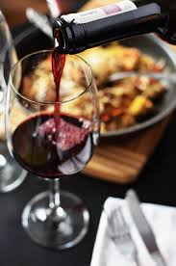
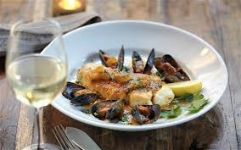

QUESTIONS??

